Slide 1
Variational Autoencoders for Anomaly Detection in IoT Data

Slide 2
Problem statement
IoT devices, such as sensors, collect large amounts of data every day.
Sometimes, things can go wrong like sensor malfunctions, sudden attacks, or
unusual behavior. Finding these unusual activities (called anomalies) is important
to keep the system working safely and correctly.
In real life, we often don’t know what abnormal data looks like, and manually labeling all data is difficult. Therefore, we need an intelligent method that can learn what normal data looks like and automatically detect anything different. This project solves the problem by using a Variational Autoencoder (VAE) a deep learning model that learns from normal data and tells us if new incoming
data is abnormal, based on its reconstruction accuracy.

Slide 3




Technologies Used
Pandas, NumPy
for data processing
Python
1
2
Matplotlib / Seaborn
for graphs and plots
4
TensorFlow
For model development
3

Slide 4

Introduction to Anomaly Detection
An anomaly means something unusual or not normal.
In IoT systems (like sensors in smart devices), anomalies may happen due to sensor failure, network issues, or attacks.
Our aim is to detect these abnormal points in the data.

Slide 5
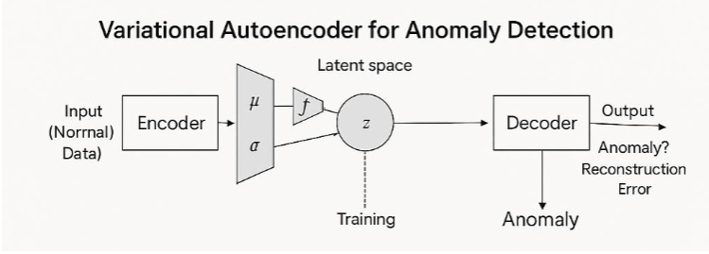
What is a Variational Autoencoder (VAE)?
A VAE is a generative model that learns
to compress data (like temperature, pressure, etc.) into a smaller, meaningful
form (called the latent space) and then reconstruct it. → Normal data can be compressed and reconstructed well. → Abnormal data (anomalies) are reconstructed poorly, and this poor reconstruction is what helps us identify anomalies.

Slide 6
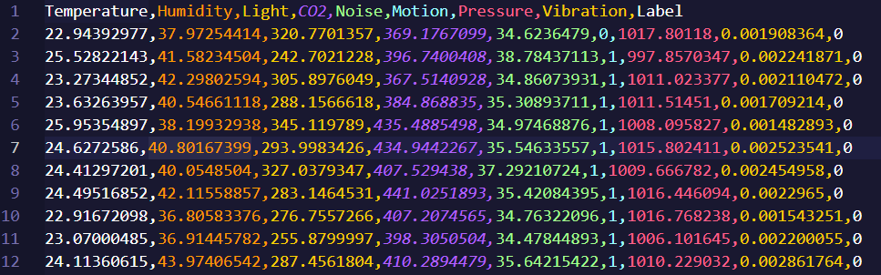
Dataset Overview
We used a CSV file named: iot_sensor_data_with_anomalies.csv
It has multiple sensor readings like Temperature, Humidity, etc.
It also has a label column: → 0 means normal data → 1 means anomaly

Slide 7
Project work flow
Load the sensor dataset
Clean and normalize the data
Train the VAE model using only normal data
Set an error threshold
Test the model on all data (normal + anomaly)
Use graphs to understand performance

Slide 8
Model Training
We trained the VAE model using 1000 normal samples
After training, we measured how much the output differed from the input
This is called reconstruction error
If the error is more than a certain limit (threshold), it is marked as
anomalyUse graphs to understand performance

Slide 9
Result – Accuracy and Evaluation
Total test samples: 1050
Anomaly detected: 50
Accuracy: 97%
Precision (Normal): 100%
Recall (Anomaly): 100%
F1 Score (Anomaly): 74% → This means the model was very good at finding anomalies
without missing any

Slide 10
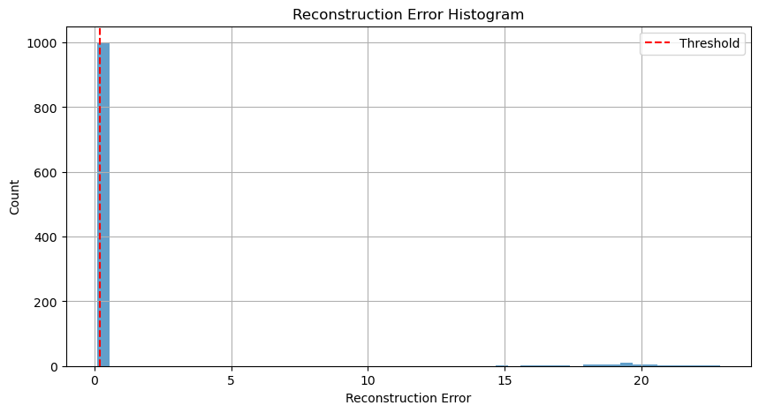
Reconstruction Error Histogram
X-axis: Reconstruction error
Y-axis: Frequency
A red dashed line shows the
anomaly threshold.
Most normal data lies below
the threshold; anomalies lie
above.

Slide 11
Benefits
Early Fault Detection: Identifies unusual behavior in sensors, helping prevent system
failures or breakdowns.
Real-Time Monitoring: Can be deployed in live IoT environments to flag anomalies instantly.
Generalizable: The same model can be adapted to different types of sensors
or IoT devices.

Slide 12
Integrate the model into real-time IT systems
Future improvement
Integrate the model into real-time IoT systems
Extend the dataset with more sensor types and real-world anomalies
Integrate with Ai

Slide 13

Thank You
Thank you for listening
Open for questions!!

